Slide 1




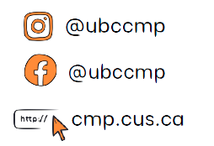

COMMERCE MENTORSHIP PROGRAM
REVIEW SESSION
COMM 204
Prepared by: Sang Nguyen and Tejsai Tagore
Instructed by: Tejsai Tagore

Slide 2
TABLE OF CONTENTS
FLOWCHART
KEY TERMS
CAPACITY RATE, BOTTLENECK ANALYSIS
LITTLE’S LAW
GANTT CHART
CRITICAL PATH (CRASHING ACTIVITIES)
P-K FORMULA
INVENTORY MANAGEMENT

Slide 3
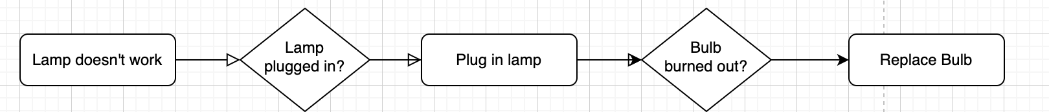
Flow Chart
Linear
Task | Duration
A | 10 mins
B | 15 mins
C | 12 mins
D | 15 mins
E | 8 mins

Slide 4
Key Terms
● Activity: A step in the process
● Resources: The performer of the activity
● Flow unit: The basic unit of analysis in any given scenario (customer, sandwich,
phone calls, etc.)
● Theoretical Flow Time/Flow Time: The amount of time a flow unit spends in a business process from
beginning to end.
● Unit load: Total amount of time that a resource needs to process a flow unit
● Capacity rate: Maximum output rate at which units can flow through a resource or
process
● Bottleneck: Resource/activity with the slowest capacity rate in a process
● Throughput rate/flow rate: Actual output rate of the process.
● Utilization Rate = Throughput rate / Capacity Rate <= 100%

Slide 5
Practice Question
For a certain chemical test at a medical company the below activity-resource chart is provided. Based on the information calculation the following.
The flow time of the process
The flowtime of the bottleneck activity.
Capacity rate of Person C
Capacity rate of the process
What happens to the capacity if there is another individual, Person F working alongside Person B?
What happens to the capacity if there is another individual, Person G working alongside Person E?
Person | Activity | Flow Time
A | Identify Requirements | 1 min
B | Testing Solutions | 3 min
C | Preparing Solutions | 2 min
D | Performing Reaction | 5 min
E | Test Analysis | 6 min

Slide 6
Practice Question
For a certain chemical test at a medical company the below activity-resource chart is provided. Based on the information calculation the following.
The flow time of the process
For calculating flow time,
(1 + 3 + 2 + 5 + 6) min = 17 min
Person | Activity | Flow Time
A | Identify Requirements | 1 min
B | Testing Solutions | 3 min
C | Preparing Solutions | 2 min
D | Performing Reaction | 5 min
E | Test Analysis | 6 min

Slide 7
Practice Question
For a certain chemical test at a medical company the below activity-resource chart is provided. Based on the information calculation the following.
B) The flowtime of the bottleneck activity.
For identifying the bottleneck activity, select the person with highest flow time here.
Person E: 6 min
Person | Activity | Flow Time
A | Identify Requirements | 1 min
B | Testing Solutions | 3 min
C | Preparing Solutions | 2 min
D | Performing Reaction | 5 min
E | Test Analysis | 6 min

Slide 8
Practice Question
For a certain chemical test at a medical company the below activity-resource chart is provided. Based on the information calculation the following.
C) Capacity rate of Person C
60*(½) = 30 units per hour (multiply by 60 for conversion)
Person | Activity | Flow Time
A | Identify Requirements | 1 min
B | Testing Solutions | 3 min
C | Preparing Solutions | 2 min
D | Performing Reaction | 5 min
E | Test Analysis | 6 min

Slide 9
Practice Question
For a certain chemical test at a medical company the below activity-resource chart is provided. Based on the information calculation the following.
D) Capacity rate of the process
60*(1/6) = 10 tests/hour
Accounting for the bottleneck activity for the process, the company is at a maximum capacity to conduct 10 tests an hour.
Person | Activity | Flow Time
A | Identify Requirements | 1 min
B | Testing Solutions | 3 min
C | Preparing Solutions | 2 min
D | Performing Reaction | 5 min
E | Test Analysis | 6 min

Slide 10
Practice Question
For a certain chemical test at a medical company the below activity-resource chart is provided. Based on the information calculation the following.
E) What happens to the capacity if there is another individual, Person F working alongside Person B?
The capacity will not change since the bottleneck for the process remains unchanged besides adding Person F to assist with conducting the chemical test. The test is still constrained by Person E’s ability to conduct the test analysis.
Person | Activity | Flow Time
A | Identify Requirements | 1 min
B | Testing Solutions | 3 min
C | Preparing Solutions | 2 min
D | Performing Reaction | 5 min
E | Test Analysis | 6 min

Slide 11
Practice Question
For a certain chemical test at a medical company the below activity-resource chart is provided. Based on the information calculation the following.
F) What happens to the capacity if there is another individual, Person G working alongside Person E?
The capacity will change since the bottleneck for the process will change by adding Person G to assist with conducting the test analysis. The test is no longer constrained by Person E’s ability to perform the designated activitiy.
Person | Activity | Flow Time
A | Identify Requirements | 1 min
B | Testing Solutions | 3 min
C | Preparing Solutions | 2 min
D | Performing Reaction | 5 min
E | Test Analysis | 6 min

Slide 12
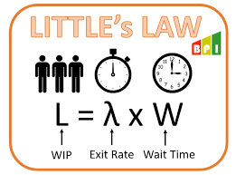
Little’s Law
Establishes a relationship between average inventory, average throughput rate, and average flow time:
I = R * T
Average Inventory (I): Average number of units or customers in the system
Average Throughput Rate (R): The average actual output rate
Average Flow Time (T): The average for a unit to move through the system

Slide 13
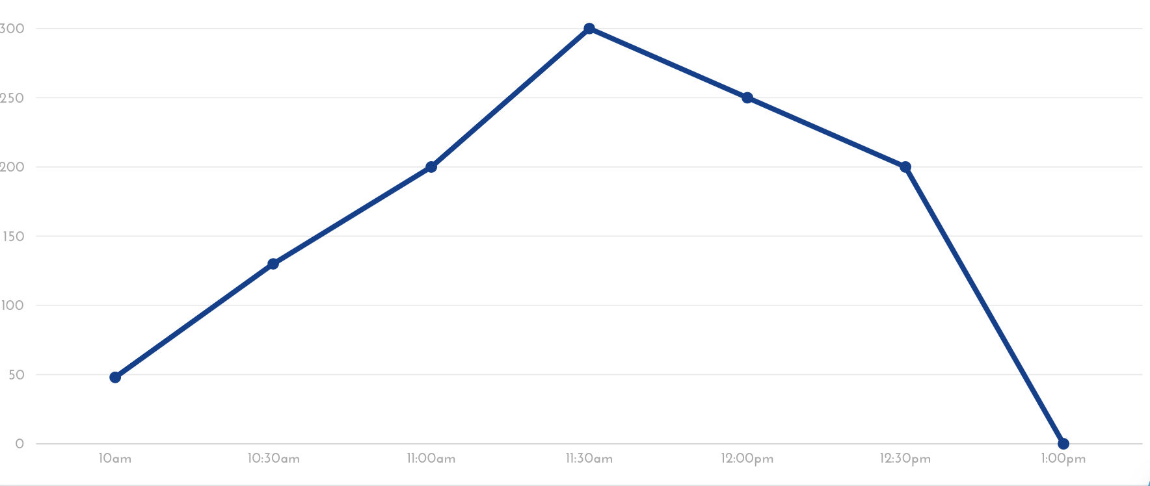
Practice Question
Below is provided the inventory buildup diagram at Lululemon for a surprise flash sale outside the UBC bookstore.
Using the diagram, calculate the average numbers of customers who visited the flash sale.

Slide 14
Practice Question
Below is provided the inventory buildup diagram at Lululemon for a surprise flash sale outside the UBC bookstore.
Using the diagram, calculate the average numbers of customers who visited the flash sale. (Inventory)
Area under the line graph
(50+130)/2*(0.5) = 45
(200+130)/2*(0.5) = 82.5
(200+300)/2*(0.5) = 125
(250+300)/2*(0.5) = 137.5
(250+200)/2*(0.5) = 112.5
(200)/2*(0.5) = 50
The average number of customers at the flash sale is 552.

Slide 15
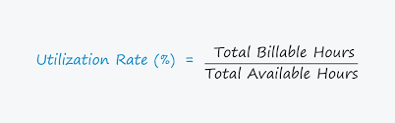
Throughput & Utilization
● Throughput rate/flow rate:
Actual output rate of the process. Depends on input rate & capacity rate:
If Input Rate < Capacity Rate: Throughput Rate = Input Rate
If Input Rate > Capacity Rate: Throughput Rate = Capacity Rate
● Utilization Rate = Throughput rate / Capacity Rate <= 100%

Slide 16
Practice Question
Below is provided the inventory buildup diagram at Lululemon for a surprise flash sale outside the UBC bookstore.
B) What is the average waiting time given that the throughput rate is 6 customers/hour?

Slide 17
Practice Question
Below is provided the inventory buildup diagram at Lululemon for a surprise flash sale outside the UBC bookstore.
B) What is the average waiting time given that the throughput rate is 6 customers/hour?
Applying Little’s Law: I = RT
Waiting Time (Flow Time) = I/R
= 552/6 = 92 hours

Slide 18
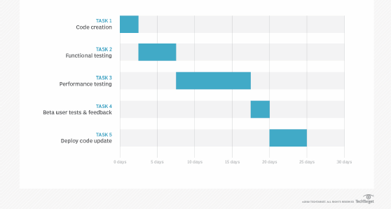
Gantt Chart

Slide 19
Critical Path
Critical path method:
● Identify all paths between the start node and the end node (Enumeration
Method)
○ For each path, add the activity times for all activities on that path
■ This path is called the critical path
■ This is the time required to finish the project
● Activity times are dependant on costs
● Crashing: refers to reducing the time it takes to complete the activity
● Crash time: the minimum possible time to complete an activity
● Crash cost: the cost associated with the crash time (in place of the normal
cost)

Slide 20
Practice Question
The LA Clippers are building a new arena and the construction process activity timeline is shown below. Please help the team figure the critical path & duration of the process.
Activity | Predecessor | Time (weeks)
A |  | 6
B | A | 3
C | A | 7
D | C | 2
E | B, D | 4
F | D | 3
G | E, F | 7

Slide 21
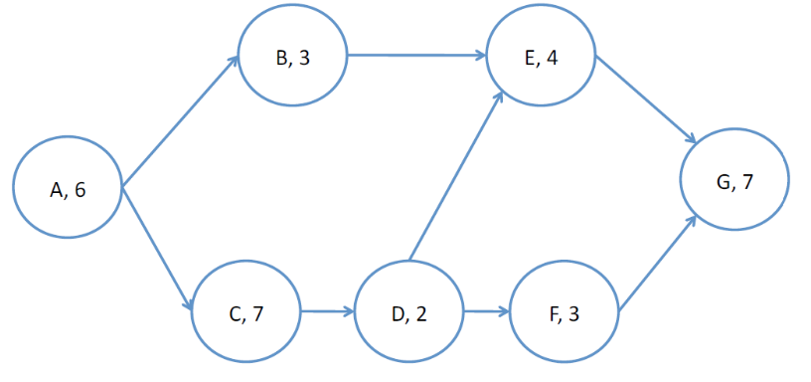
Practice Question
The LA Clippers are building a new arena and the construction process activity timeline is shown below. Please help the team figure the critical path & duration of the process.
ABEG: 2O weeks (6+3+4+7)
ACDEG: 26 weeks (6+7+2+4+7)*
ACDFG: 25 weeks (6+7+2+3+7)
Therefore the duration of the project is 26 weeks since it takes the longest.
Activity | Predecessor | Time (weeks)
A |  | 6
B | A | 3
C | A | 7
D | C | 2
E | B, D | 4
F | D | 3
G | E, F | 7

Slide 22
Practice Question
For the given project activity below, reduce the project completion time to 24 weeks if possible. Give the crashing cost as well. If not possible, clearly state why.
Activity | Predecessor | Time (weeks) | Crash Time (weeks) | Cost
A |  | 6 | 3 | $90
B | A | 3 | 2 | $40
C | A | 7 | 2 | $50
D | C | 2 | N/A
E | B, D | 4 | N/A
F | D | 3 | N/A
G | E, F | 7 | N/A

Slide 23
Practice Question
For the given project activity below, reduce the project completion time to 24 weeks if possible. Give the crashing cost as well. If not possible, clearly state why.
Identify all the required paths.
ABEG: 2O weeks (6+3+4+7)
ACDEG: 26 weeks (6+7+2+4+7)*
ACDFG: 25 weeks (6+7+2+3+7)
The critical path is ACDEG with 26 weeks needed for completion.
Cost of Crashing A: $30/week
Cost of Crashing B: $20/week
Cost of Crashing C: $25/week
Crashing the cheapest activity on the critical path, Activity B by 2 weeks.
Crashing cost = $40 (2*$20/week)
Therefore the crashing cost for reducing the project duration to 24 weeks is $40 if the team chooses to do so.

Slide 24
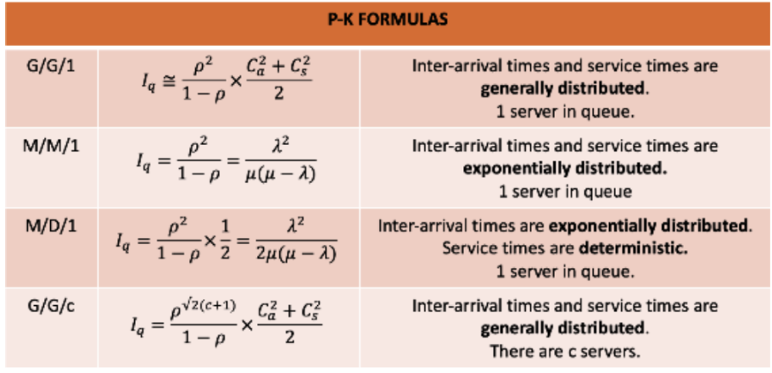
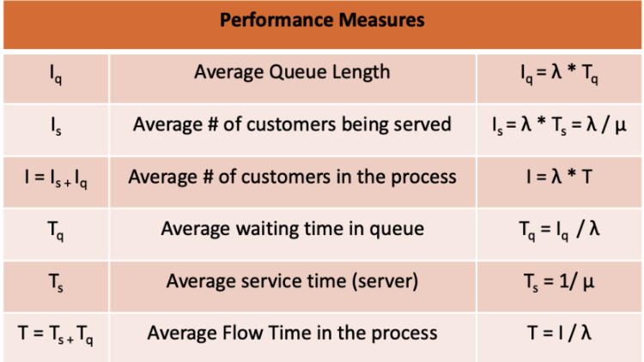
P-K Formula

Slide 25
Practice Question
A bank installs an ATM and observes that the customers arrive at a rate of 15 customers per hour and the arrivals follow a Poisson distribution (the interval time between two customers has an exponential distribution). The ATM has a fixed non-random service time of 3 minutes per customer
(a) Calculate the average time spent by a customer in this system

Slide 26
Practice Question
A bank installs an ATM and observes that the customers arrive at a rate of 15 customers per hour and the arrivals follow a Poisson distribution (the interval time between two customers has an exponential distribution). The ATM has a fixed non-random service time of 3 minutes per customer
(a) Calculate the average time spent by a customer in this system
By the P-K formula, λ = 15 customers/hr μ = 1/3 = 20 customers/hr
ρ = λ/μ = ¾
Iq = ρ^2/(1−ρ)*(Ca^2+Cs^2)/2 = 1.125 customers
By Little’s Law, Tq = Iq/λ = 1.125/15 = 0.075 hours
Ts = 1/μ = 1/20 = 0.05 hour
T = Ts + Tq = 0.075+0.05 = 0.125 hours

Slide 27
Practice Question
A bank installs an ATM and observes that the customers arrive at a rate of 15 customers per hour and the arrivals follow a Poisson distribution (the interval time between two customers has an exponential distribution). The ATM has a fixed non-random service time of 3 minutes per customer
(b) What is the percentage of time that the ATM is idle?

Slide 28
Practice Question
A bank installs an ATM and observes that the customers arrive at a rate of 15 customers per hour and the arrivals follow a Poisson distribution (the interval time between two customers has an exponential distribution). The ATM has a fixed non-random service time of 3 minutes per customer
(b) What is the percentage of time that the ATM is idle?
As mentioned in the last part,
utilization: ρ = λ/μ = 3/4 = 0.75 (or 75% of the time)
Idle Time (100-75) = 25%
Thus, the ATM is idle for 25% of the time.

Slide 29
Inventory Management
Variables:
D: Annual Demand Rate
Q: Batch Size
S: Cost
C: Cost per unit
I: Interest Rate
H1: Annual Holding & Storage Cost
[(2SDH)^½ ]
(D/Q)*S: Annual Setup Cost
(Q/2)*H: Annual Holding Cost
Q(opt): ((2SD)/H)^½
F(opt): ((DH)/2S)^½
Newsvendor Model:
Co: Overage cost, cost of having too much inventory
Cu: Underage cost, cost of having insufficient inventory
NV Ratio: Cu/(Cu+Co)
S: mean + sd(z-score)
P [D<=S]: Cu/(Cu+Co)

Slide 30
Practice Question
The NBA has an annual demand for 1000 Lebron James’ jerseys. The processing cost is $500 and each jersey costs $50, with a 5% carrying interest rate.
What is the restock frequency?
Find the optimal quantity
What is total annual cost?
What is the reorder cost?

Slide 31
Practice Question
The NBA has an annual demand for 1000 Lebron James’ jerseys. The processing cost is $500 and each jersey costs $50, with a 5% carrying interest rate.
D=1000, S=$500, H = iC = 2.5
What is the restock frequency?
F(opt): ((DH)/2S)^½
((1000*2.5)(1000))^½ = 1.5 per year
Find the optimal quantity
Q(opt): ((2SD)/H)^½
((2*500*1000)/2.5))^½ = 632 (approx. jerseys)

Slide 32
Practice Question
The NBA has an annual demand for 1000 Lebron James’ jerseys. The processing cost is $500 and each jersey costs $50, with a 5% carrying interest rate.
D=1000, S=$500, H = iC = 2.5
3. What is total annual cost?
= (2SDH)^½ = 2(500*1000*2.5)^½ = $1,580 (approx)
4. What is the reorder cost?
= DS/Q = (1000*500)/632 = $791

Slide 33
Practice Question
Now, consider the NBA has an annual demand for Lebron James’ jerseys with a mean of 50 and a standard deviation of 100. Each jersey still costs $50, and is sold for $100. Not sold jerseys can be redeemed for $35.
How many jerseys should the NBA buy?

Slide 34
Practice Question
Now, consider the NBA has an annual demand for Lebron James’ jerseys with a mean of 50 and a standard deviation of 100. Each jersey still costs $50, and is sold for $100. Not sold jerseys can be redeemed for $35.
How many jerseys should the NBA buy?
Mean: 50, SD: 100
Co: 50-35 = $15, Cu: 100-50 = $50
p = 50/65 = 76.9%
z = 0.73
Jerseys = mean + sd(z-score)
= 50 + 100(0.73) = 123

Slide 35
Inventory Management (cont’d)
Different Types:
Moving Average: Ft = [A(t-1)+A(t-2)+......+A(t-n)]/n
Weighted Moving Average: W1A(t-1)+......+WnA(t-n)
Exponential: F(t-1) + α(A(t-1) - F(t-1))
Forecasting:
Ft: Forecast at time t
At: Actual inventory at time T
n: periods
w: associated weight value

Slide 36
Practice Question
Look at the table below: Find A, B, C, D. Write N/A where applies.
Month | Demand | Forecast (3 months)
January | 500 | A
February | 600 | B
March | 750 | C
April | 1000 | D

Slide 37
Practice Question
Month | Demand | Forecast (3 months)
January | 500 | A
February | 600 | B
March | 750 | C
April | 1000 | D
A, B, C are N/A since we need at least 3 months lead time to conduct the forecasting:
D = (500+ 600 + 750)/3 = 616.67

